Slide 1
Review – 3 Customer and Product Segmentation in Commerce
Submitted by:
Pranay Pratik (20BCE1751)
Aayush Shukla (20BCE1500)
Ambati sesha sai sahithya (20BCE1605)

Slide 2
What is Customer Segmentation?
The practice of breaking customers into groups based on common features so that firms may market to each group effectively and appropriately,” according to the definition of customer segmentation.
Companies can identify the proper clients for targeted and relevant offerings by employing the right attributes to establish the customer segment. Data quality is consumer segmentation.
In most cases, inaccurate data in source systems leads to poor grouping. Individual clients, for example, typically employ attributes such as age, gender, and marital status. The segments will be erroneous if these properties are not correctly preserved, and the information will be less helpful as a result.

Slide 3
Defining customer quality or value: The final business goals that the project will address or contribute to after it is completed. These objectives should, ideally, overlap or be connected with the strategic objectives of your organization. The total net present value of a customer's cumulative profits created during their lifetime is known as customer value.
Advertising through tags: We may have a single customer that solely buys beauty products from you. That customer needs to be labeled. In fact, every consumer who purchases beauty products from that store should be labeled in the company's contact database with the tag "beauty products." Business should target such customers with advertisements for beauty products they are likely to buy.

Slide 4
What problem are we trying to solve?
We are trying to help companies to deploy customer segmentation. Customer Segmentation is the process of division of customer base into several groups of individuals that share a similarity in different ways that are relevant to marketing such as gender, age, interests, and miscellaneous spending habits.

Slide 5
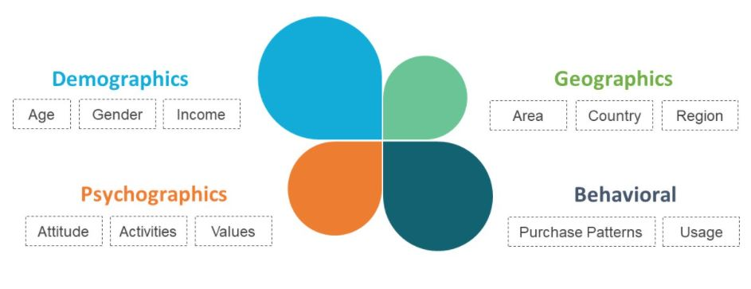
Types of Customer Segmentation

Slide 6
Objectives
Customer Gender Visualization
We will create a bar plot and a pie chart to show the gender distribution across our customer dataset.
Analysis of the Annual Income of the Customers.
We will create visualizations to analyze the annual income of the customers. We will plot a histogram and then we will proceed to examine this data using a density plot.
Visualization of Age Distribution
Analyzing Spending Score of the Customers
Determining Optimal Clusters
K-means clustering

Slide 7
Abstract
The importance of treating customers as an organizations main asset is increasing in value in present day and era. Organizations have an interest to invest in the development of customer acquisition, maintenance and development strategies.
The business intelligence has a vital role to play in allowing companies to use technical expertise to gain better customer knowledge and Programs for outreach.
By using clustering techniques like k-means, customers with similar means are clustered together. Customer segmentation helps the marketing team to recognize and expose different customer segments that think differently and follow different purchasing strategies.

Slide 8
Customer segmentation helps in figuring out the customers who vary in terms of preferences, expectations, desires and attributes. The main purpose of performing customer segmentation is to group people, who have similar interest so that the marketing team can converge in an effective marketing plan.
Clustering is an iterative process of knowledge discovery from vast amounts of raw and unorganized data. Clustering is a type of exploratory data mining that is used in many applications, such as machine learning, classification and pattern Recognition.

Slide 9
About Dataset
The dataset (Mall_Customers) comprises of Customer Id, gender, age, annual income (k), Spending Score (1-100), Number of items bought, Invoice id, Branch, City, Customer type, product line, unit price, quantity, tax 5%, total, Date, time, payment, cogs, gross margin percentage, gross income, rating.
This dataset is taken from Kaggle.

Slide 10
Operations on Dataset
We will use this dataset to perform customer analysis i.e., behavioural patterns which the customer shows, what factors influence particular customers buying a particular product, age, annual income, spending score.
Product analysis is also being conducted based on what factors influence sales of a particular product, Unit price of product vs items sold, Product line and age group falls in it, also time of items bought, can be factored to Product line to predict price rise or drop of particular product.

Slide 11
Project Modules
Data cleaning
Depicting the ratio between male and female customers
Distribution of Age Group of customers
Descriptive analysis of Age based on the sales
Analysis of Annual income vs items purchased

Slide 12
Project Modules
6. Comparison Analysis of total item sold Vs Branch
7. Descriptive analysis of product line w.r.t each Branch
8. Density plot of Rating Vs Branch
9. Analysis of Product sold date Vs Product Line

Slide 13
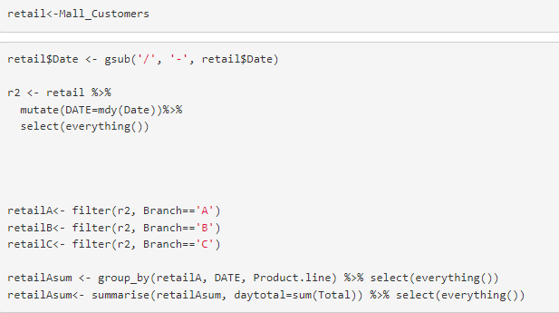
1. Data Modification
Date column is filtered based on the branch and new data frame is created to analyse.

Slide 14
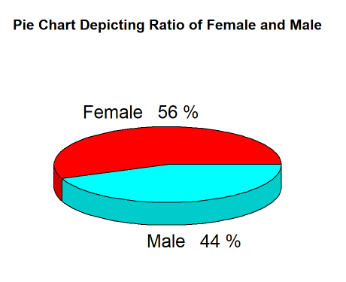
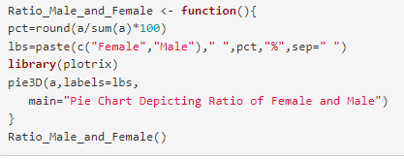
2. Depicting the ratio between male and female customers

Slide 15
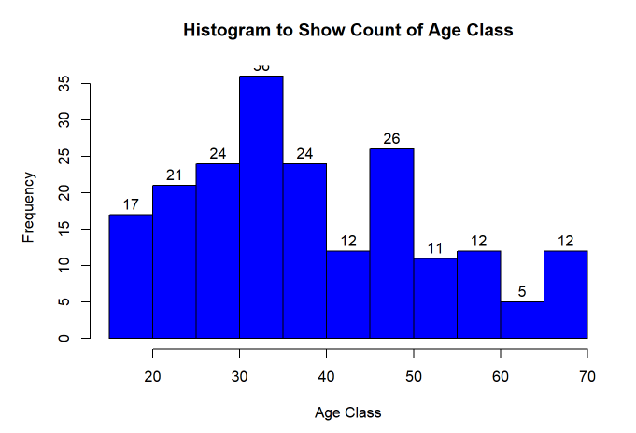
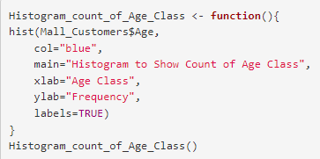
3. Distribution of Age Group of customers

Slide 16
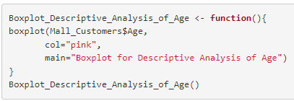
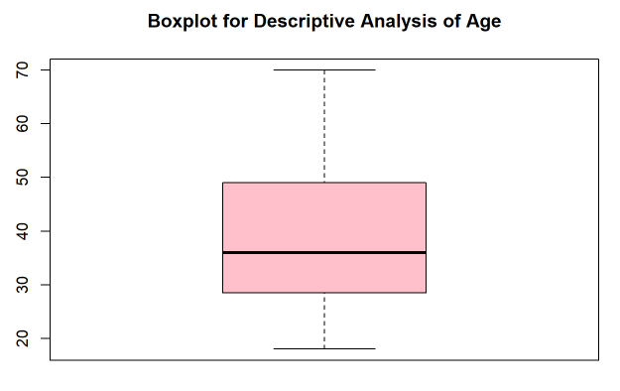
4. Descriptive analysis of Age based on the sales

Slide 17
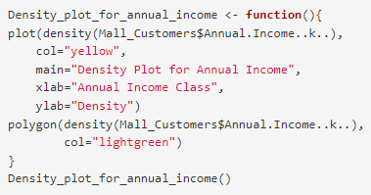
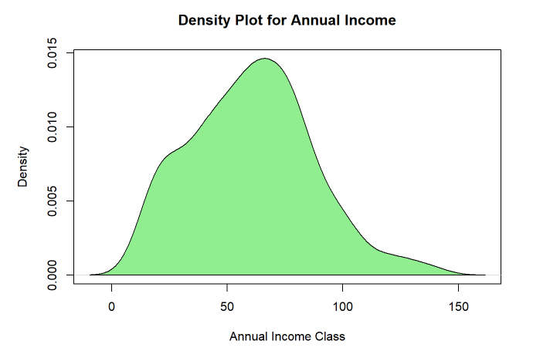
5. Analysis of Annual income vs items purchased

Slide 18
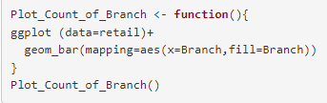
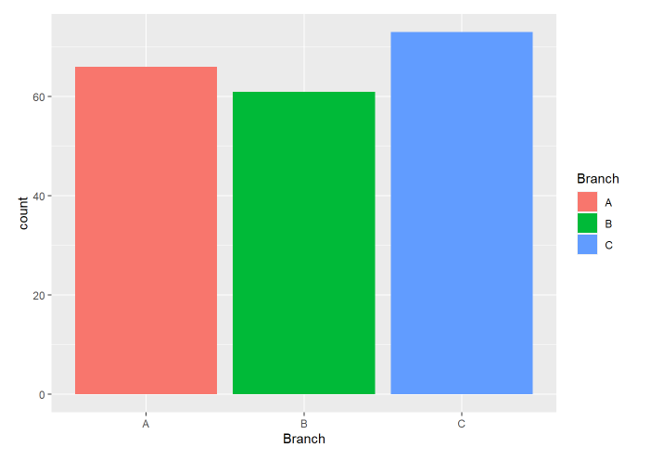
6. Comparison Analysis of total item sold Vs Branch

Slide 19
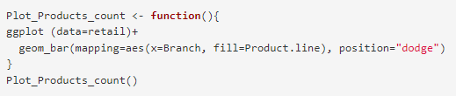
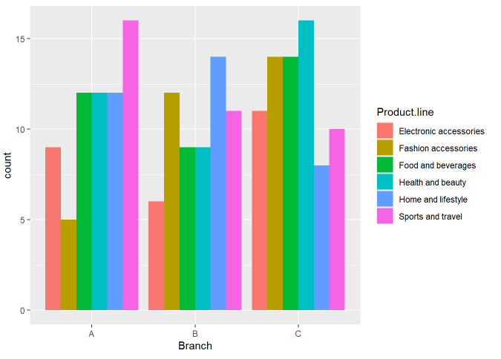
7. Descriptive analysis of product line w.r.t each Branch

Slide 20
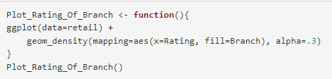
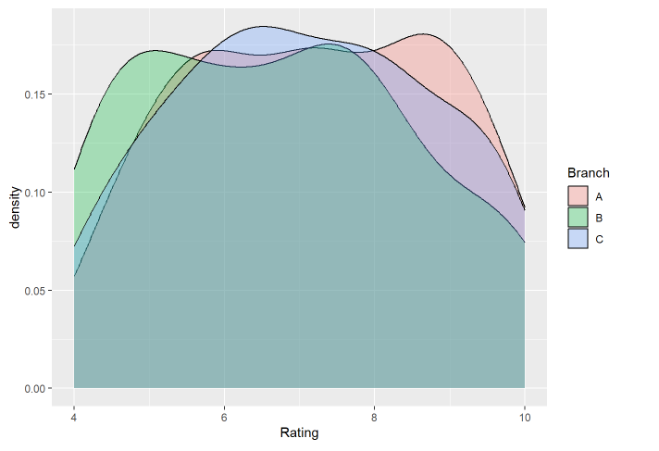
8. Density plot of Rating Vs Branch

Slide 21
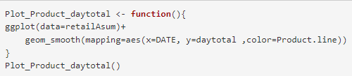
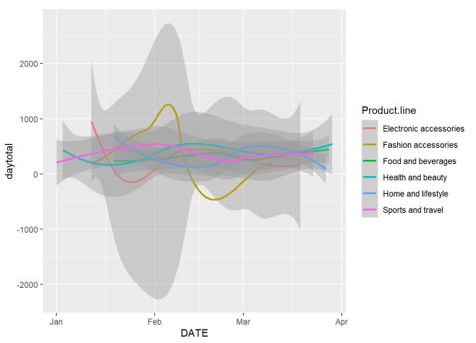
9. Analysis of Product sold date Vs Product Line

Slide 22
Performance metrics
We are going to cluster the our customers based on the 3 attributes of chosen dataset.
Annual Income, Total Shopping done and their spending score based on it.
K-means Algorithm will be used to do make the clusters.
So to find the best fitting value of k (clusters), we use the ELBOW method.
Elbow method displays plot dissimilarities of points Vs k (clusters)
Uses SSE (sum of squared error) to find dissimilarities.
Peak turn in plot depicts the best fitting value for k

Slide 23
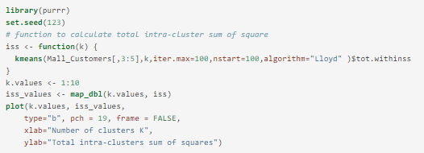
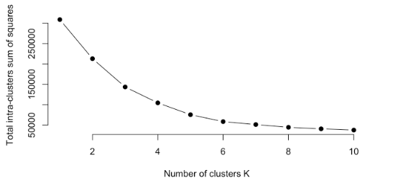
Elbow Method
Therefore, the value of k = 6

Slide 24
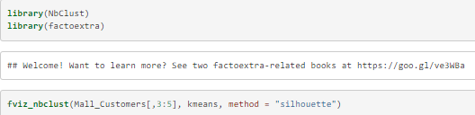
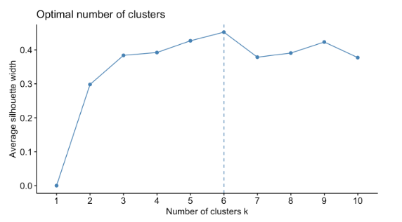
Average Silhouette Method
Therefore, the value of k = 6

Slide 25

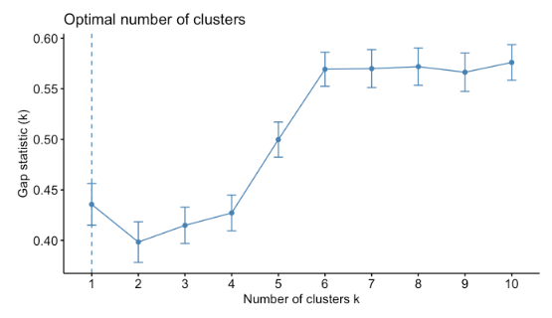

Gap Statistic Method

Slide 26
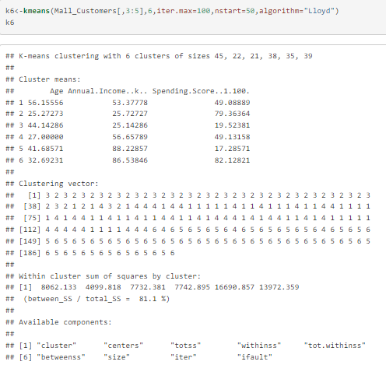
Conclusion
The optimal value of k = 6 from each method.
Applying k-means making 6 clusters of dataset

Slide 27
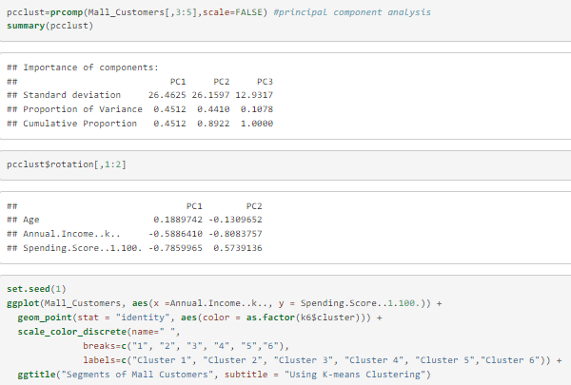
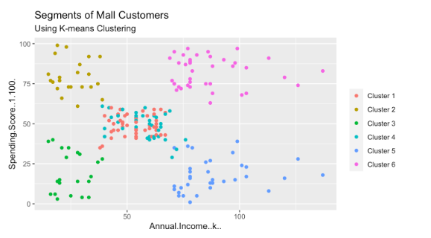
Conclusions

Slide 28
Conclusions
From the above visualization, we observe that there is a distribution of 6 clusters as follows –
Cluster 6 and 4 – These clusters represent the customer_data with the medium income salary as well as the medium annual spend of salary.
Cluster 1 – This cluster represents the customer_data having a high annual income as well as a high annual spend.
Cluster 3 – This cluster denotes the customer_data with low annual income as well as low yearly spend of income.
Cluster 2 – This cluster denotes a high annual income and low yearly spend.
Cluster 5 – This cluster represents a low annual income but its high yearly expenditure.

Slide 29
Publicity – Github Link
https://github.com/AayushShukla03/Product-and-Customer-Segmentation

Slide 30
Contribution of Members
Pranay Pratik– Dataset formation, Data cleaning, Data imputation, Documentations
Aayush – Dataset formation, Graph visualizations, Coding(R), Documentations
Sahithya – Data cleaning, Data imputation, Algorithm deployment, Documentations

Slide 31
